Slide 1
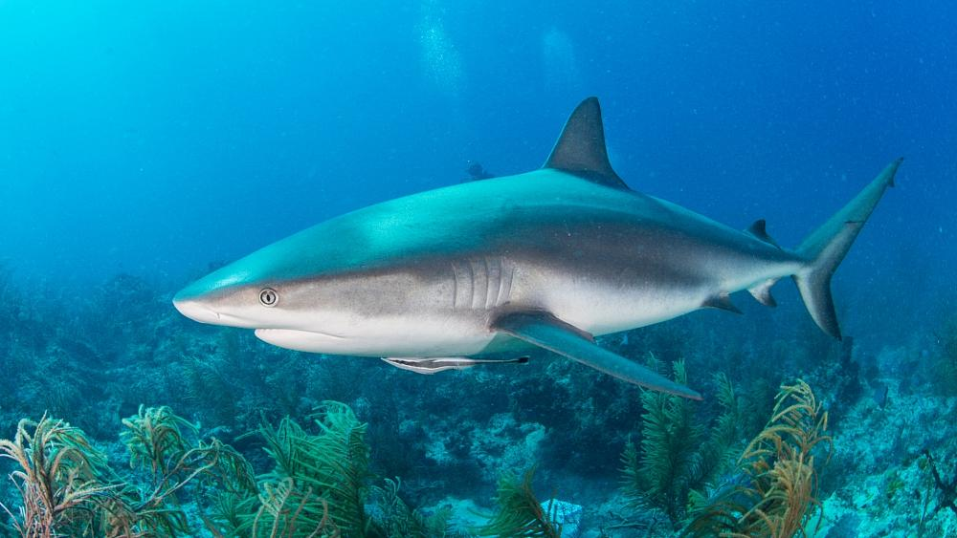
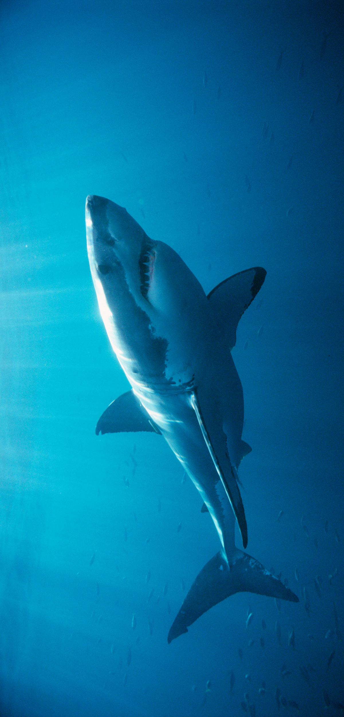
Shark Attacks
Analyzed by: Henry Martinez

Slide 2
This data set consists of 6000 shark attack cases categorized by 24 different variables.

Slide 3

Research Questions
Which State in the USA has the most reported shark attacks?
What type of shark attack occurs the most among women & among men ?
What age group makes up the most shark attacks?

Slide 4
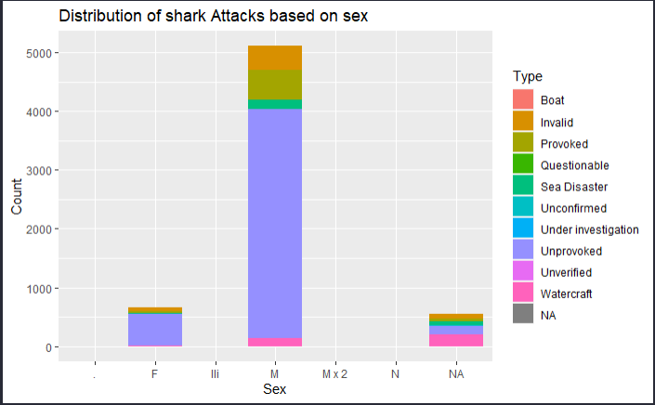
A bar graph comparing whether males or females are more prominent in these shark attacks.

Slide 5
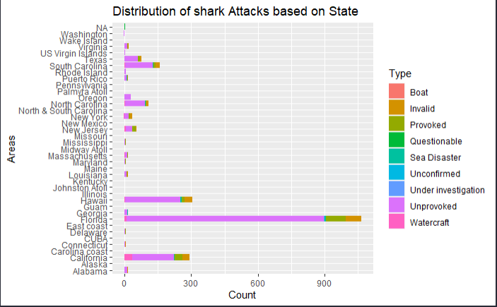
This Graph shows the quantity of shark attacks in certain areas of the US.

Slide 6
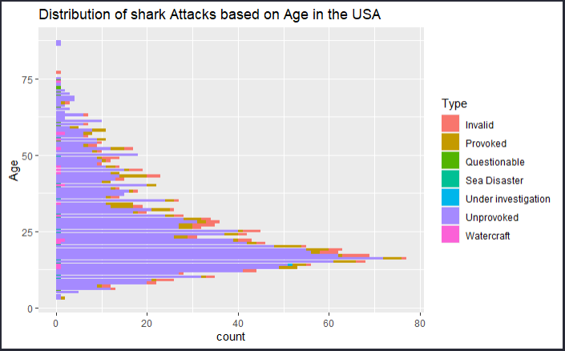
This is a visualization of the age group in the US that made up the majority of these shark attacks.

Slide 7
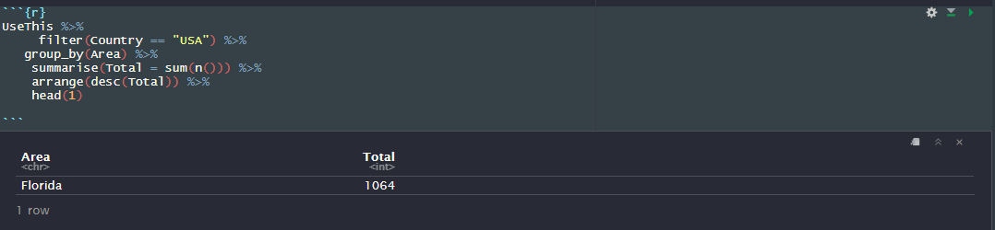
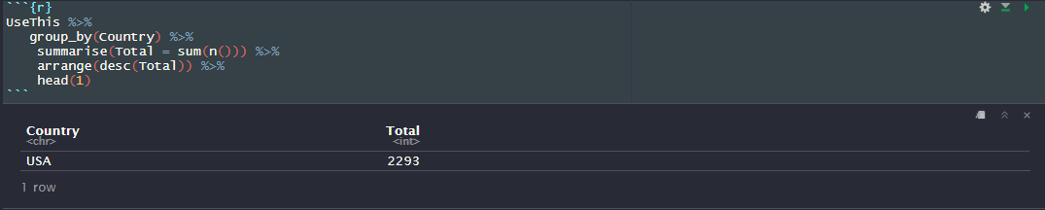
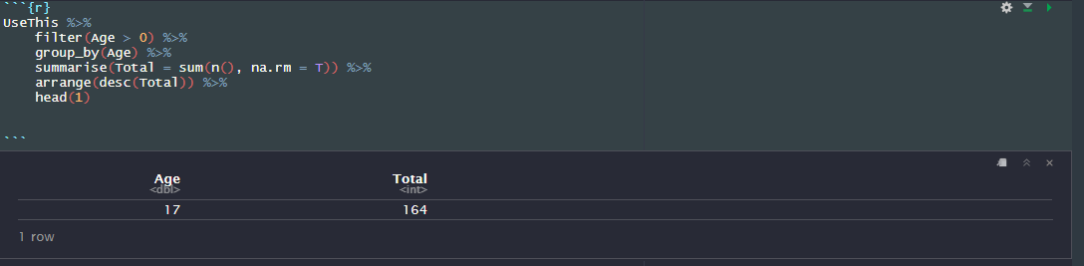

Slide 8
Summarise
After exploring this data set I was able to gleam some insights off the trends I noticed.
We learned that the USA has reported the most cases of shark attacks, 17 year olds make up the majority of these attacks, and Florida holds the title in the US for having the most reported cases. While covid is still in place, not much can be said about the findings from this dataset.
However, more can be done with this dataset. Predictions can be made for the frequency of shark attacks in areas after covid has passed. Ranking can be made for Countries boasting the lowest reports of shark attacks and reasoning could also be provided.

